Slide 1
WELCOME TO MODULE 7
WINDOWS SCRIPTING & COMMAND LINE

Slide 2
Here below are all section that we are going to cover in this module.
Section I- WINDOWS BATCH SCRIPTING
Section II- FIRST BATCH SCRIPT
Section III- INTRODUCTION TO POWERSHELL & ITS IMPORTANCE
Section IV- SCRIPT TO AUTOMATE SIMPLE TASKS
Section VI- WINDOWS POWERSHELL
Section VII- POWERSHELL COMMAND LINE
Section VIII- WINDOWS POWERSHELL ISE
Section IX- WINDOWS MANAGEMENT INSTRUMENT (WMIC)
Section X- DIFFERENCE BETWEEN DOS & POWERSHELL

Slide 3
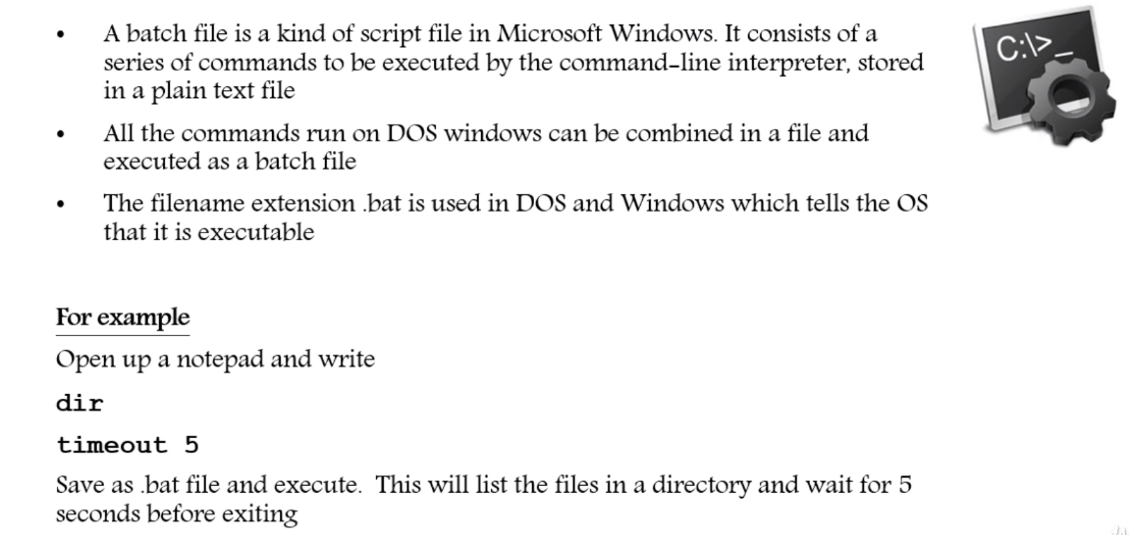
Section I- WINDOWS BATCH SCRIPTING

Slide 4
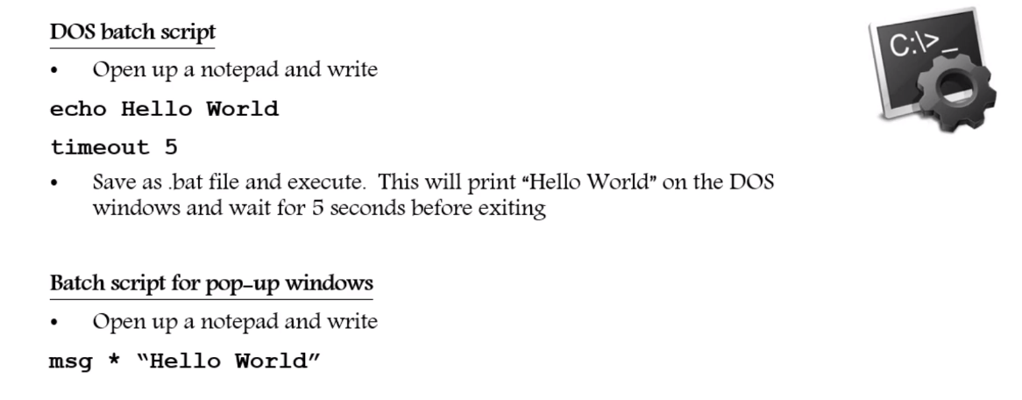
Section II- FIRST BATCH SCRIPT

Slide 5
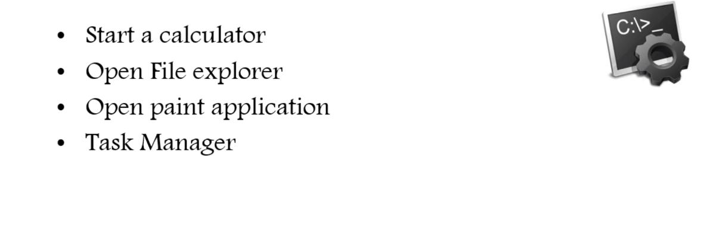
SCRIPT TO AUTOMATE SIMPLE TASKS

Slide 6
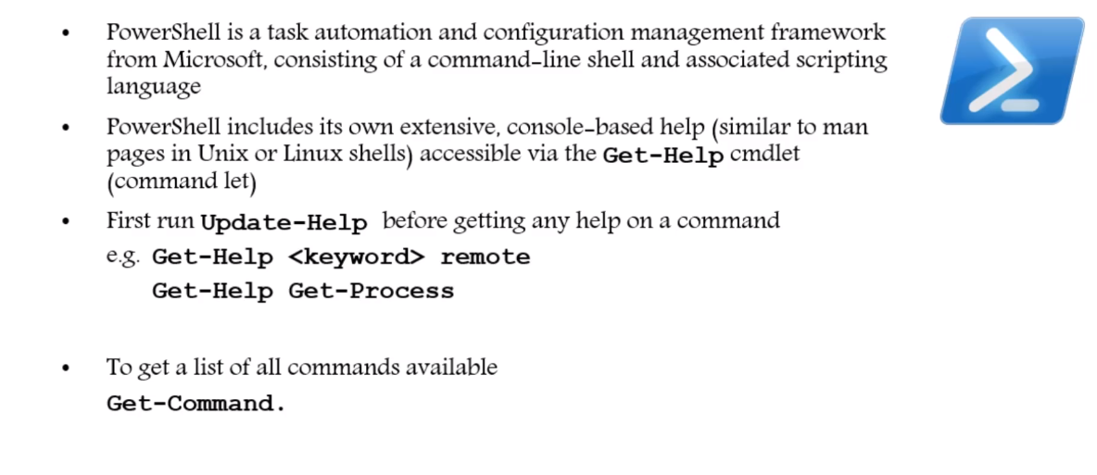
Section III- INTRODUCTION TO POWERSHELL & ITS IMPORTANCE

Slide 7
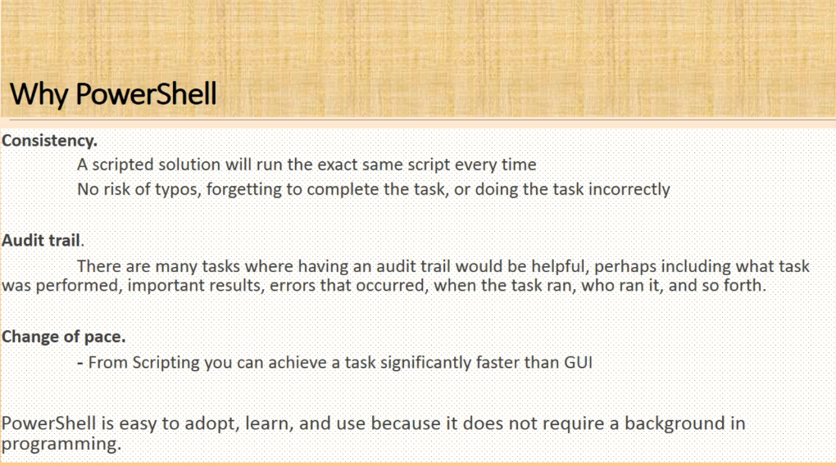
Why powershell ?

Slide 8
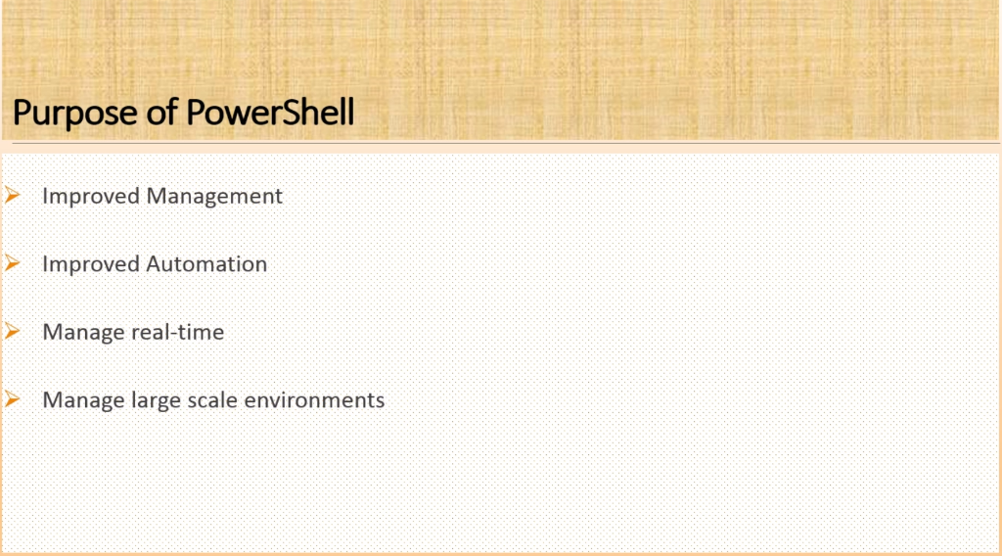

Slide 9
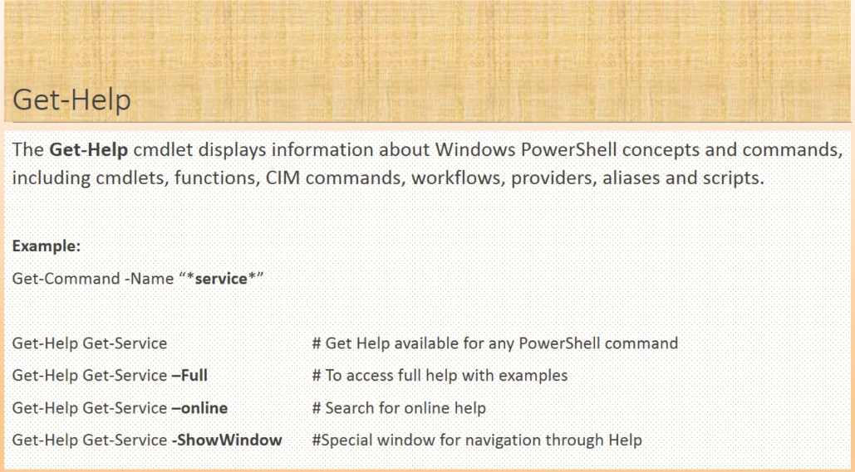

Slide 10
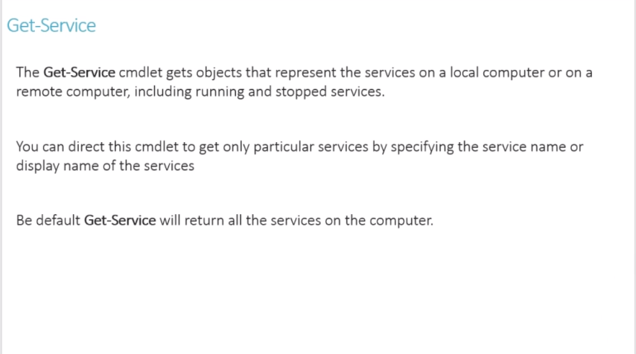

Slide 11
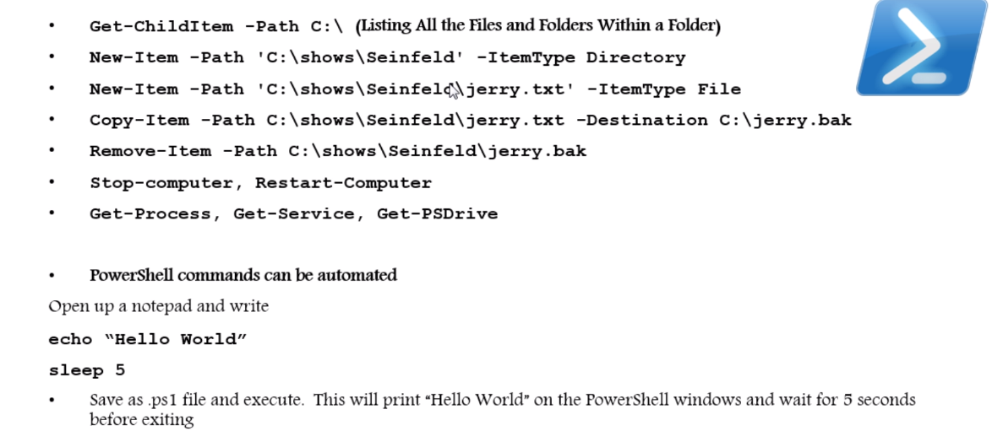
Section VII- POWERSHELL COMMAND LINE

Slide 12
Section VIII- WINDOWS POWERSHELL ISE
PowerShell is developed for configuration management and automation of tasks. ... PowerShell ISE is expanded as PowerShell Integrated scripting environment which is a graphical user interface that enables the user to execute commands, create and modify the scripts directly on the GUI instead of typing as a command.

Slide 13
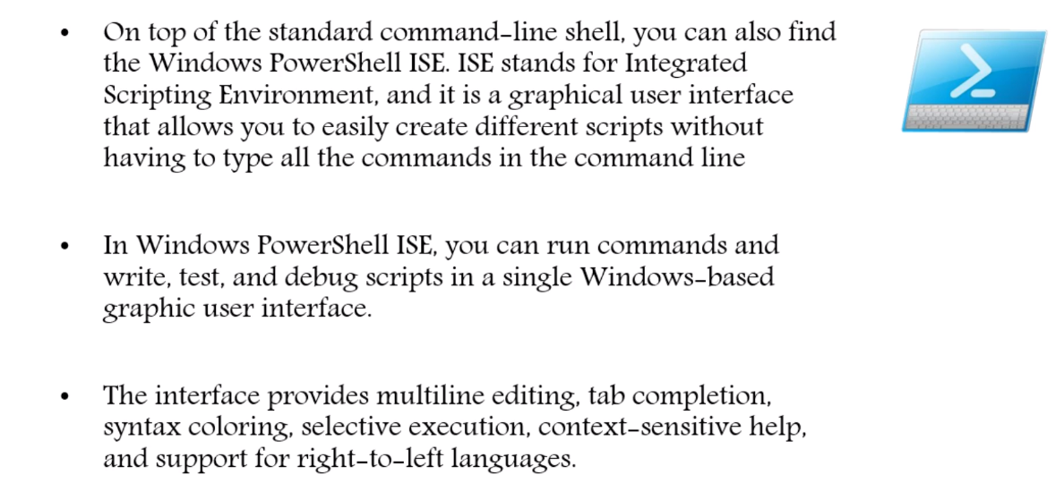

Slide 14
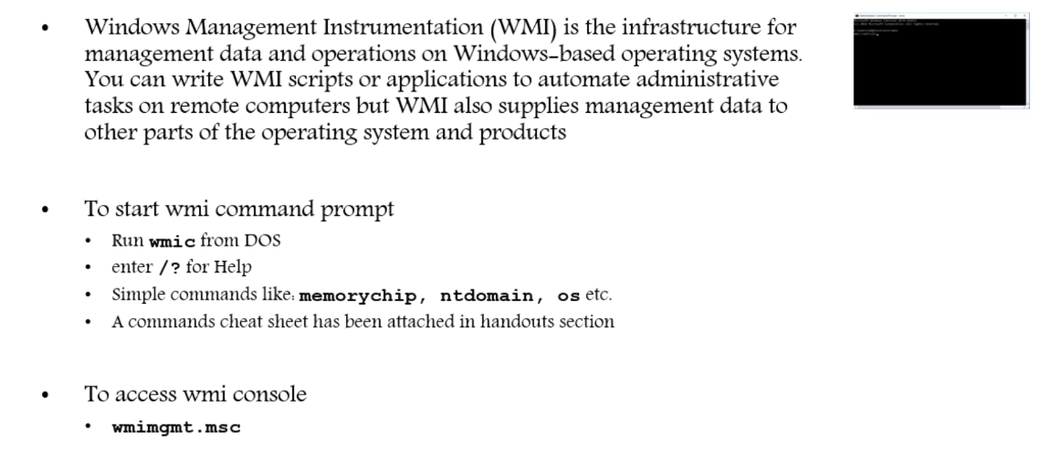
Section IX- WINDOWS MANAGEMENT INSTRUMENT (WMIC)

Slide 15
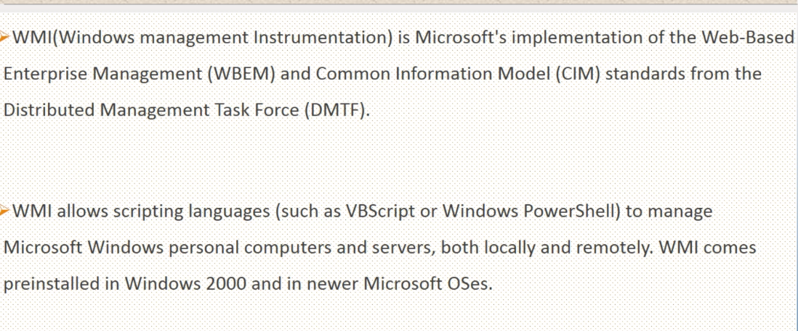

Slide 16
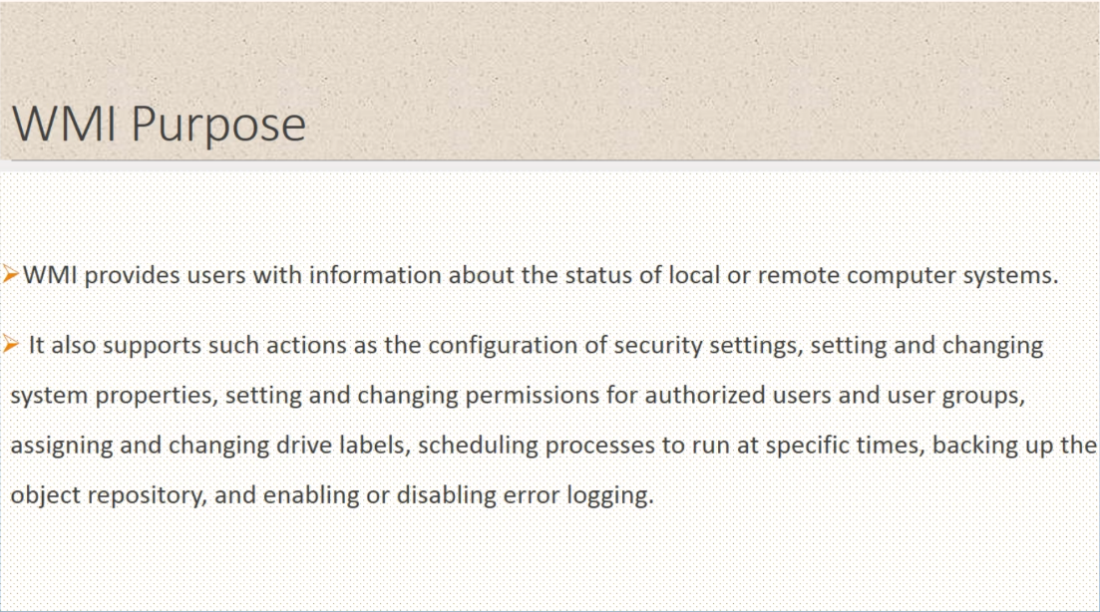

Slide 17
